Slide 1

BIG DATA
Class Project: FPL
K V Subramaniam
Computer Science and Engineering

Slide 2

BIG DATA
Class Project: FPL
K V Subramaniam
Computer Science and Engineering

Slide 3
BIG DATA
Introduciton

Slide 4
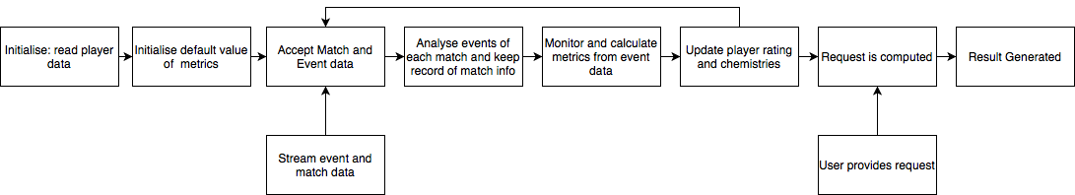
BIG DATA
Aim
Rate and rank players
Real time analysis of match event data
Compute strength of team
Predict rating of player

Slide 5
BIG DATA
Requirements
Use only Spark to do this assignment
PySpark library can be used
Use Spark Mllib for clustering and regression
No native python code will be allowed, all code must be compatible with PySpark and executed on Spark
Use Streaming spark to accept the streamed match and event data

Slide 6
BIG DATA
Initialisation
Players.csv will provide the background info for all players, this info will be a part of player profile
A streaming file will be provided that will stream match data on port 6100
Read match event data from 6100
At the beginning of a match a match JSON object is sent and then events JSON objects are sent for that match.
Not all data streamed will be useful, be careful while processing and discard data not required for your use case

Slide 7
BIG DATA
Match JSON
Field | Description
competitionId | the identifier of the competition to which the match belongs to. It is a integer and refers to the field "wyId" of the competition document;
date and dateutc | the former specifies date and time when the match starts in explicit format (e.g., May 20, 2018 at 8:45:00 PM GMT+2), the latter contains the same information but in the compact format YYYY-MM-DD hh:mm:ss;
duration | the duration of the match. It can be "Regular”, “ExtraTime”, “Penalties”
gameweek | the week of the league, starting from the beginning of the league;
roundID | indicates the match-day of the competition to which the match belongs to.
seasonId | indicates the season of the match;
status | it can be "Played”, "Cancelled”, "Postponed" or "Suspended”;
venue | the stadium where the match was held (e.g., "Stadio Olimpico");
winner | the identifier of the team which won the game, or 0 if the match ended with a draw;
wyId | the identifier of the match

Slide 8
BIG DATA
Match JSON Contd.
teamsData: it contains several subfields describing information about each team that is playing that match: such as lineup, bench composition, list of substitutions, coach and scores:
Sub-field | Description
hasFormation | it has value 0 if no formation (lineups and benches) is present, and 1 otherwise;
score | the number of goals scored by the team during the match (not counting penalties);
scoreET | the number of goals scored by the team during the match, including the extra time (not counting penalties);
scoreHT | the number of goals scored by the team during the first half of the match;
scoreP | the total number of goals scored by the team after the penalties;
side | the team side in the match (it can be "home" or "away");
teamId | the identifier of the team;
coachId | the identifier of the team's coach;
bench | the list of the team's players that started the match in the bench and some basic statistics about their performance during the match (goals, own goals, cards);
lineup | the list of the team's players in the starting lineup and some basic statistics about their performance during the match (goals, own goals, cards);
substitutions | the list of team's substitutions during the match, describing the players involved and the minute of the substitution.

Slide 9
BIG DATA
Events JSON
Field | Description
eventId | the identifier of the event's type. Each eventId is associated with an event name (see next point);
eventName | name of the event's type. There are seven types of events: pass, foul, shot, duel, free kick, offside and touch;
subEventId | the identifier of the subevent's type. Each subEventId is associated with a subevent name (see next point);
subEventName | the name of the subevent's type. Each event type is associated with a different set of subevent types;
tags | a list of event tags, each one describes additional information about the event (e.g., accurate). Each event type is associated with a different set of tags;
eventSec | the time when the event occurs (in seconds since the beginning of the current half of the match);
id | a unique identifier of the event;
matchId | the identifier of the match the event refers to
matchPeriod | the period of the match. It can be "1H" (first half of the match), "2H" (second half of the match), "E1" (first extra time), "E2" (second extra time) or "P" (penalties time);
playerId | the identifier of the player who generated the event.
positions | the origin and destination positions associated with the event.
teamId | the identifier of the player's team.

Slide 10
BIG DATA
Processing

Slide 11
BIG DATA
Step 1
Read players.csv file
Compute the following form event data for each player, as events are streamed:
Pass accuracy
Duel Effectiveness
Free kick effectiveness
Shots on target
Foul loss
Own Goals

Slide 12
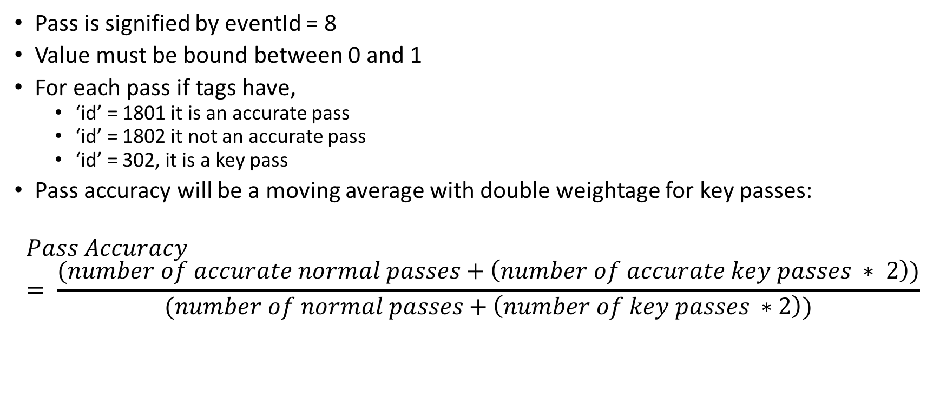
BIG DATA
Pass Accuracy
Pass is signified by eventId = 8
Value must be bound between 0 and 1
For each pass if tags have,
‘id’ = 1801 it is an accurate pass
‘id’ = 1802 it not an accurate pass
‘id’ = 302, it is a key pass
Pass accuracy will be a moving average with double weightage for key passes:
$$Pass Accuracy= \frac{(number of accurate normal passes+\left(number of accurate key passes ∗ 2\right))}{(number of normal passes+\left(number of key passes ∗2\right))}$$

Slide 13
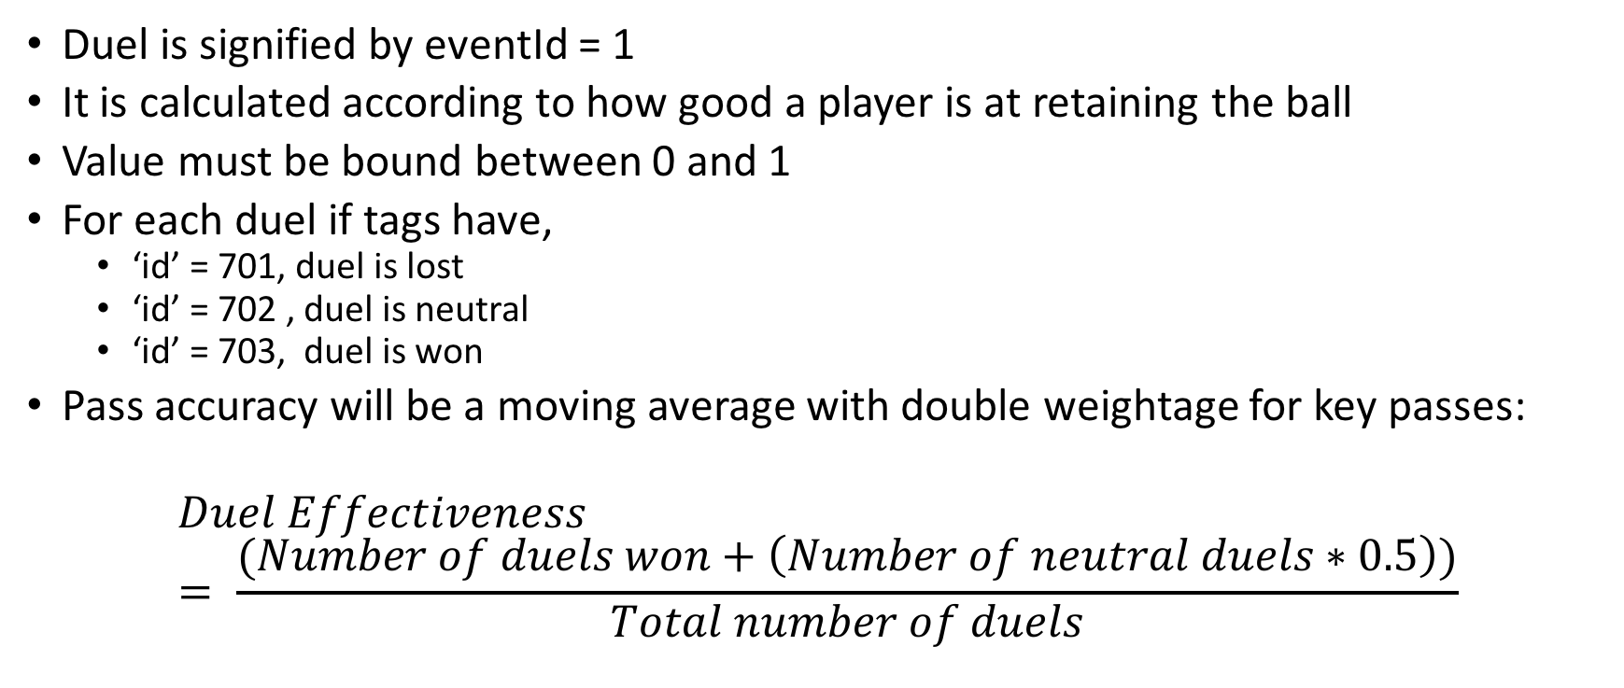
BIG DATA
Duel Effectiveness
Duel is signified by eventId = 1
It is calculated according to how good a player is at retaining the ball
Value must be bound between 0 and 1
For each duel if tags have,
‘id’ = 701, duel is lost
‘id’ = 702 , duel is neutral
‘id’ = 703, duel is won
Pass accuracy will be a moving average with double weightage for key passes:
$$Duel Effectiveness= \frac{(Number of duels won+\left(Number of neutral duels∗0.5\right))}{Total number of duels}$$

Slide 14
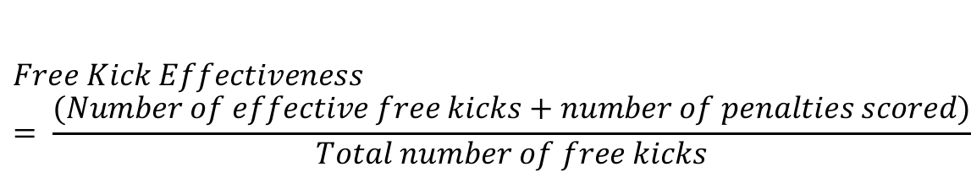
BIG DATA
Free Kick Effectiveness
Free Kick is signified by eventId = 3
Value must be bound between 0 and 1
For each free kick if tags have,
‘id’ = 1801, free kick is effective
‘id’ = 1802, free kick is not effective
If subEventId = 35, the free kick is a penalty and in such a case if tags has Id = 101, the penalty was a goal. Some penalties can be effective but may not be a goal.
$$Free Kick Effectiveness= \frac{(Number of effective free kicks+number of penalties scored)}{Total number of free kicks}$$

Slide 15
BIG DATA
Shots Effectiveness
Shot is signified by eventId = 10
Value must be bound between 0 and 1
For each shot if tags have,
‘id’ = 1801, shot is on target
‘id’ = 1802, shot is not on target
‘id’ = 101, shot was a goal
$$Shot Effectiveness= \frac{(Shots on target and goals+\left(Shots on target but not gaols∗0.5\right))}{Total shots}$$

Slide 16
BIG DATA
Shots on Target
Shot is signified by eventId = 10
Value must be bound between 0 and 1
For each shot if tags have,
‘id’ = 1801, shot is on target
‘id’ = 1802, shot is not on target
‘id’ = 101, shot was a goal
$$Shot Effectiveness= \frac{(Shots on target and goals+\left(Shots on target but not gaols∗0.5\right))}{Total shots}$$

Slide 17
BIG DATA
Foul Loss
Foul is signified by eventId = 2
Count number of fouls committed by each player
Player contribution will be penalised for number of fouls committed

Slide 18
BIG DATA
Own Goal
If for any event, the tags has id = 102, it is an own goal
Count number of own goals scored by each player
Player contribution will be penalised for number of own goals scored

Slide 19
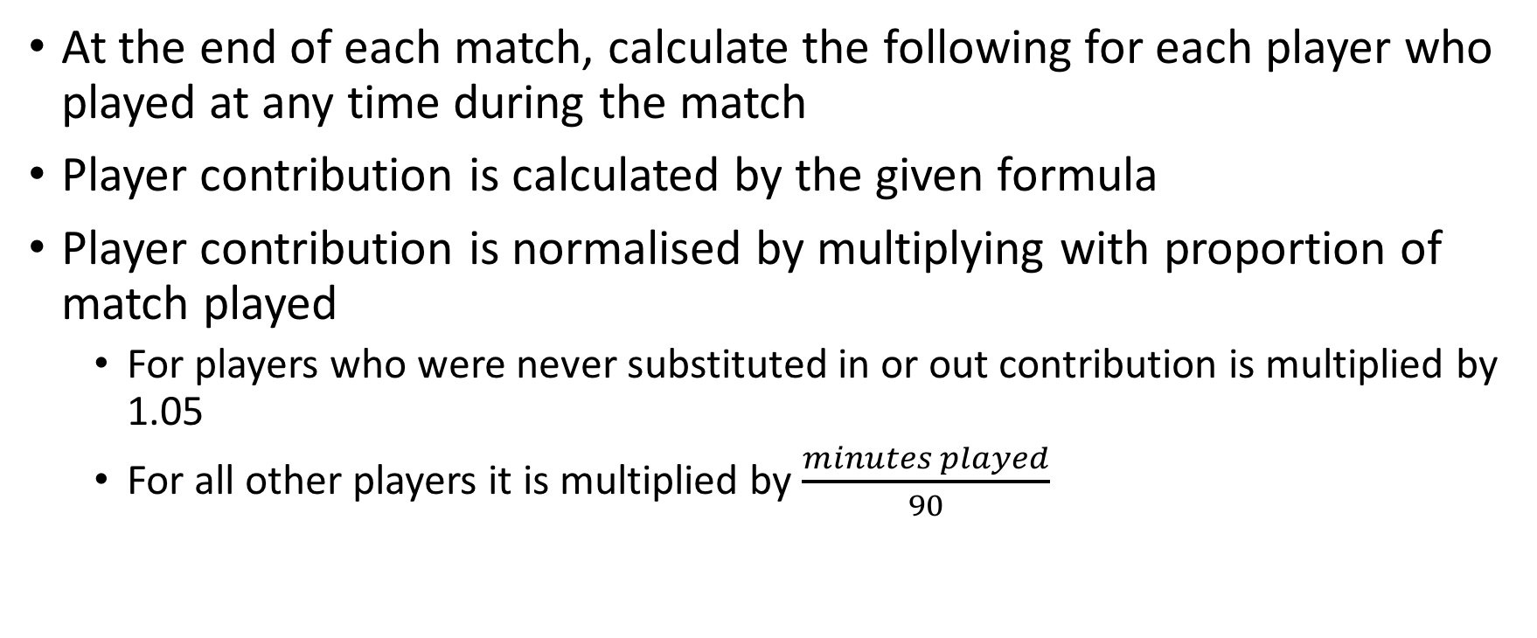
BIG DATA
Player Contribution
At the end of each match, calculate the following for each player who played at any time during the match
Player contribution is calculated by the given formula
Player contribution is normalised by multiplying with proportion of match played
For players who were never substituted in or out contribution is multiplied by 1.05
For all other players it is multiplied by $\frac{minutes played}{90}$
$$Player contribution= \frac{(pass accuracy+duel effectiveness+free kick effectiveness+shots on target )}{4}$$

Slide 20
BIG DATA
Player Rating
After computing player contribution, calculate player rating
Initially, the rating of every player is 0.5
Player performance is calculated by reducing the contribution by 0.5% for every foul committed by the player and 5% for every own goal
Player rating is calculated by the given formula
$$Player rating=\frac{(player performance+existing player rating \text{)}}{2}$$

Slide 21
BIG DATA
Chemistry between Pairs of Players
Chemistry is to be calculated for each pair of players in the dataset
Chemistry between each pair of players is initially 0.5
After every match update the chemistry of all pairs of players who played
Value must be bound between 0 and 1
After every match,
for a pair of a players in the same team, the change in chemistry is absolute value of the average of the change in rating of both players. If rating of both players increased or decreased then chemistry increases but if rating of one player increased while that of other decreased, then chemistry decreases by same value.
for a pair of a players in the opposing teams, the change in chemistry is absolute value of the average of the change in rating of both players. If rating of both players increased or decreased then chemistry decreases but if rating of one player increased while that of other decreased, then chemistry increases by same value.

Slide 22
BIG DATA
Examples
If Rashford and Salah are playing on opposite sides and their ratings go up by 0.02 and 0.06 respectively, then their chemistry will go down by 0.04
If Bale and Ozil are playing on the same team and their ratings go up by 0.07 and down by 0.03 respectively, then their chemistry will go down by 0.02
If Pogba and Kane are playing on opposing teams and their ratings go up by 0.07 and down by 0.03 respectively, then their chemistry will go up by 0.02

Slide 23
BIG DATA
Examples
If Rashford and Salah are playing on opposite sides and their ratings go up by 0.02 and 0.06 respectively, then their chemistry will go down by 0.04
If Bale and Ozil are playing on the same team and their ratings go up by 0.07 and down by 0.03 respectively, then their chemistry will go down by 0.02
If Pogba and Kane are playing on opposing teams and their ratings go up by 0.07 and down by 0.03 respectively, then their chemistry will go up by 0.02

Slide 24
BIG DATA
Player Profile
Maintain profile of each player
All data from the players dataset must be available on the profile
Profile should also have the following data, as of at the end training data:
Number of Fouls
Number of Goals
Number of Own Goals
Pass Accuracy
Shots on Target

Slide 25
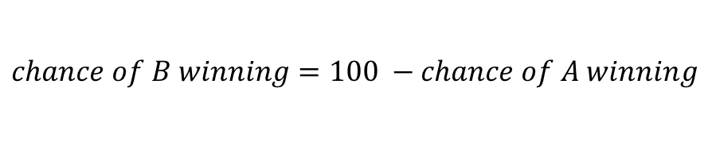
BIG DATA
Predict Winning Chances
For a pair of teams, comprising 11 players each predict the winning chance:
For each player of a team, average of all chemistry coefficients with all other members of that team
Multiply this consolidated chemistry coefficient with the rating of that player to give player strength
Find the team’s overall strength by averaging the player strength of the 11 players
Predict winning chance from team overall strength from given formula
$$chance of A winning=\left(0.5+strength of A − \frac{Strength of A +Strength of B}{2} \right)∗100\%$$
$$chance of B winning=100 −chance of A winning$$

Slide 26
BIG DATA
Problems
Some players may not have played enough matches in the given data to accurately assess their ratings
Ratings of players are a function of their age and thus will change according to when match is held

Slide 27
BIG DATA
Solution: Clustering
Cluster players into 5 groups to approximate rating and chemistry coefficient for players who have played less than 5 matches in training data
Cluster based on the profile of the players
Take average rating and chemistry coefficient of cluster for players who have played less than 5 matches

Slide 28
BIG DATA
Solution: Regression
Use non linear (quadratic) regression to model the change in player’s rating with age
When a user provides teams for a match and match date, use regression to get the player’s rating at that date and the compute winning chance

Slide 29
BIG DATA
User Interface
Users can provide a date of a match and 2 teams of 11 players each
System must ensure that the list of players have:
1 Goalkeeper
At least 2 defenders
At least 2 Mid fielders
And at least 1 Forward
Return Invalid team in case the above conditions are not met
After regression make sure that the rating of any player is not below 0.2, if any player has a rating of less than 0.2, return that the player has retired
If all conditions are met, return chance of either team winning the match
GUI is not required, file can be read from command like and written to a destination

Slide 30
BIG DATA
User Interface
User can request the profile of each player
User can request details of any match from training data by providing match label and date
The system should read a JSON file for the request from the user and write back a JSON file as result

Slide 31
BIG DATA
Marks Break up
Task | Marks
Accepting Streamed data on streaming spark | 2
Compute metrics for each match | 2
Maintaining player profile | 2
Clustering | 3
Regression | 3
Prediction of winning chances | 1
Processing request and giving response | 3 (1 Each)
Report | 2
Viva and Demo | 2

Slide 32
BIG DATA
Other Info
Due Date: 01/12/2020
Final Report: the submission has to be accompanied by a final report which should outline your inferences and findings from the data and problems and difficulties faced while doing the project.

Slide 33
THANK YOU
K V Subramaniam
Computer Science and Engineering
subramaniamkv@pes.edu
+91 80 6666 3333 Extn 877

